Slide 1
Lecture 6 Application in Model Checking
Transition systems and traces
Safety properties and invariants
Model-checking regular safety properties

Slide 2
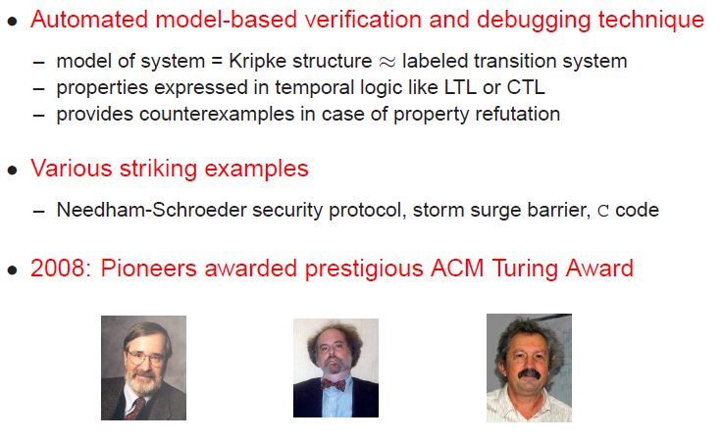
Model checking

Slide 3
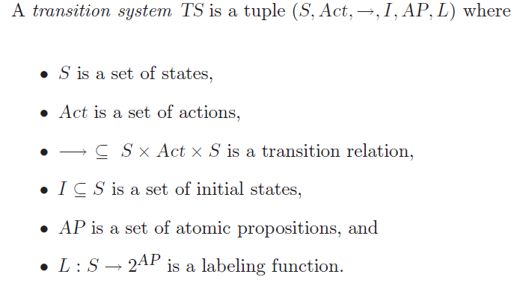
Transition system (TS)

Slide 4
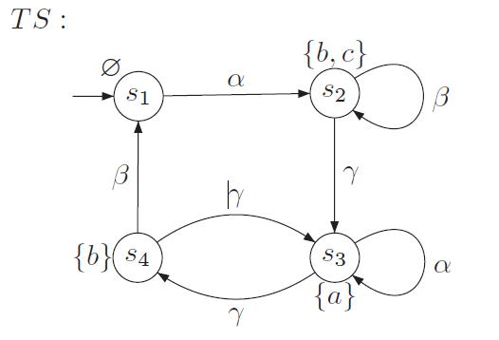
Example
AP={a,b,c}

Slide 5
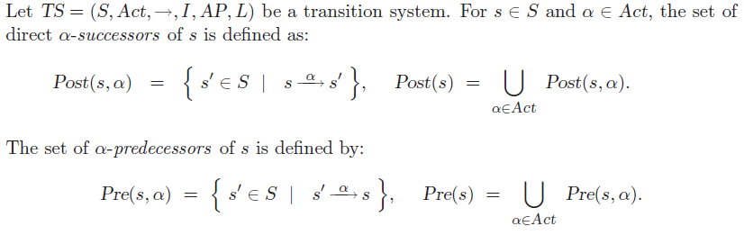
Some notions

Slide 6

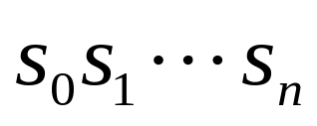




Some more notions
A finite path fragment of TS is a finite state sequence such that for all , where . An infinite path fragment is an infinite state sequence such that for all i>0
A maximal path fragment is either a finite path fragment that ends in a terminal state or an infinite path fragment. A path fragment is called initial if it starts in an initial state.
A path is an initial, maximal path fragment.
Path(TS) denotes the set of all paths in TS, and Pathfin(TS)
The set of all initial finite path fragments of TS.

Slide 7
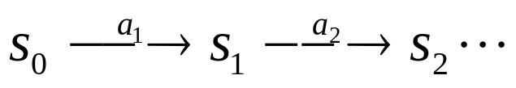

Traces
We consider states instead actions; in particular, since states are not observable, we focus on their labeling atomic propositions.
For example, for an execution of the form
we consider the sequences L(s1)L(s2)L(s3)… . Such sequences are called traces.
The traces of a transition system are thus words or strings over the alphabet
The alphabet is NOT AP!!!!

Slide 8
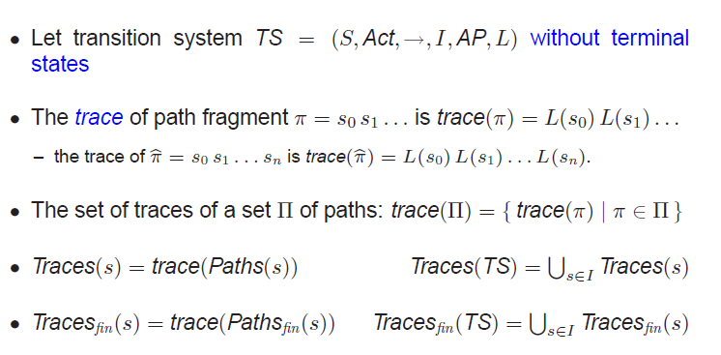
Traces

Slide 9
Example
AP={a,b,c}

Slide 10
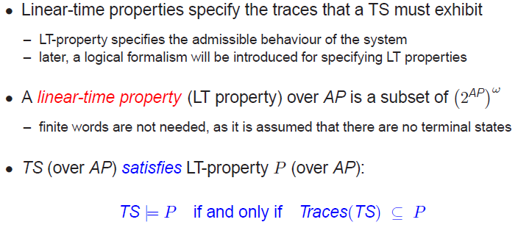
Linear-time (LT) properties

Slide 11
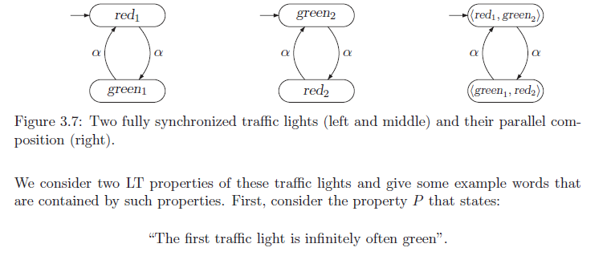
Example

Slide 12

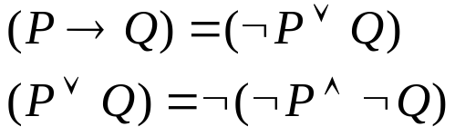
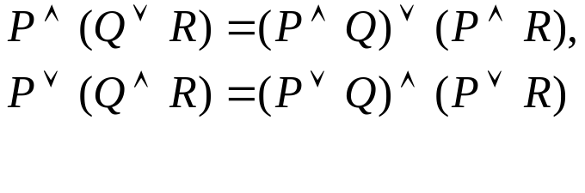
Propositional (Boolean) Logic
Boolean operations: negation, conjunction (AND), disjunction (OR)
where p is an atomic proposition
Equivalent expressions
The distributive laws

Slide 13



Satisfaction
Assume that
is satified at A if the conjunction of atomic propositions at A is the positive conjuncts in the DNF of .
  For example, assume that AP={a, b,c}, then
So is satisfied at a state s if L(s)|= .

Slide 14
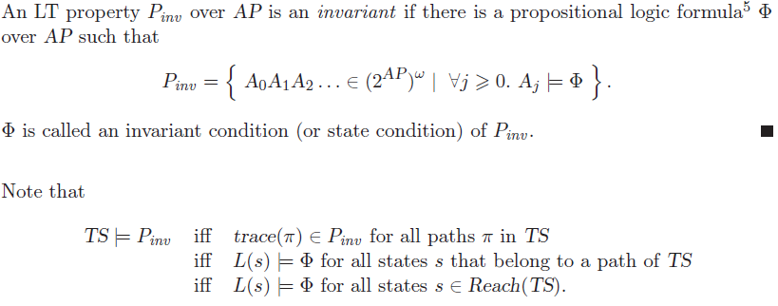
Invariants
Invariant is a state property!

Slide 15
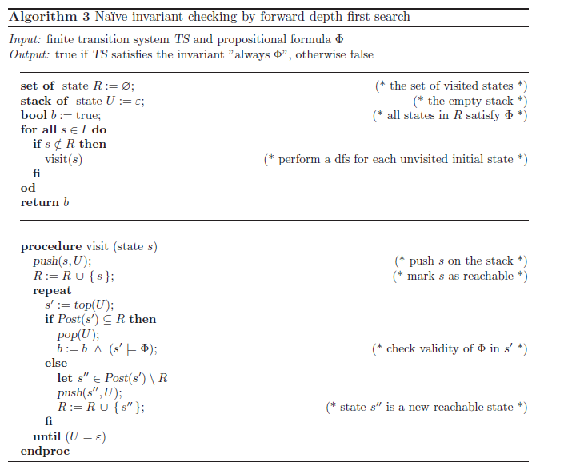

Slide 16
Example
Take Pinv =a /\ b/\ c
R: the set of reachable states
U: to be checked whether
invariant is satisfied
b: whetherthe invariant is satisfied
at all reachable states

Slide 17
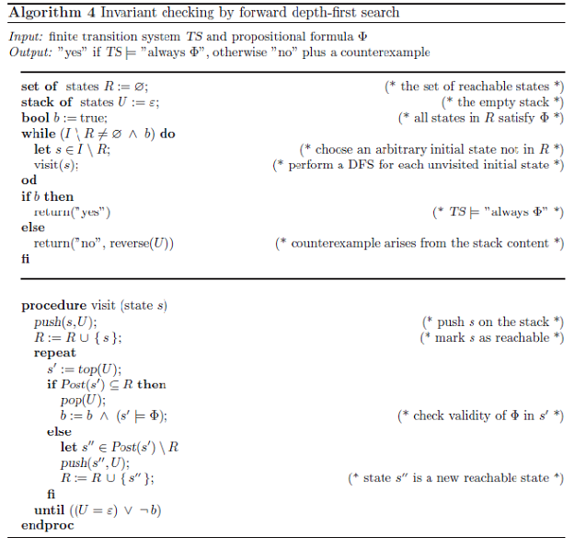

Slide 18



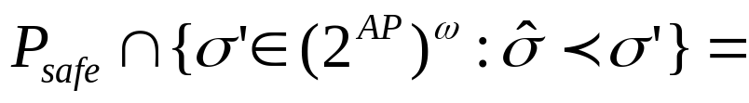
Safety properties and bad prefixes
An LT property Psafe over AP is called a safety property if for all words there exists a finite prefx of such that
0

Slide 19

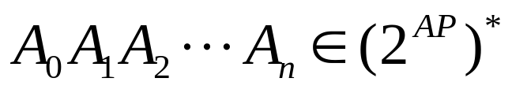

Minimal bad prefixes
Any invariant is a safety property. For a propositional formula and its invariant Pinv , all finite words of the form
with constitute the minimal bad prefixes for Pinv
not
But the converse is not true.

Slide 20
Characterization of safety properties
For transition system TS without terminal states and safety property Psafe

Slide 21
A safety property for a traffic light
The atomic propositions are red, green, and yellow. They serve to mark the states describing a phase.
Specify the following properties:
  “always at least one of the lights is on”
  “It is never the case that two lights are switched on at the same time”
  “A red phase must be preceded immediately by a yellow phase”
Are these properties safe? If yes, what are their corresponding (minimal) bad prefixes?

Slide 22
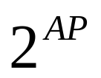
Regular safety properties
Safety property Psafe over AP is called regular if its set of bad prefixes constitute a regular language over
Every invariant is a regular safety property.
Property: “A red phase must be preceded immediately by a yellow phase”
~yellow&~red
~Yellow
Yellow
q1
q0
red
q2
~red&Yellow
Note: this safety is not an invaraint.

Slide 23




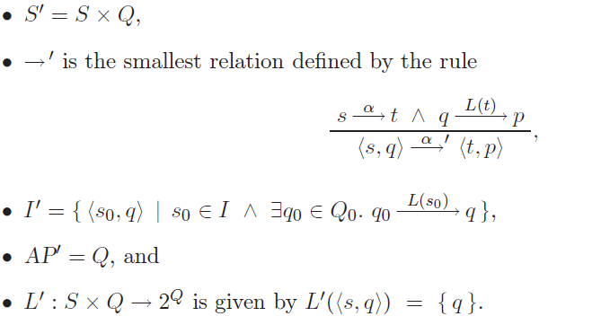
Product of Transition system and NFA
Let be a transition system without terminal states and an NFA with the alphabet

Slide 24
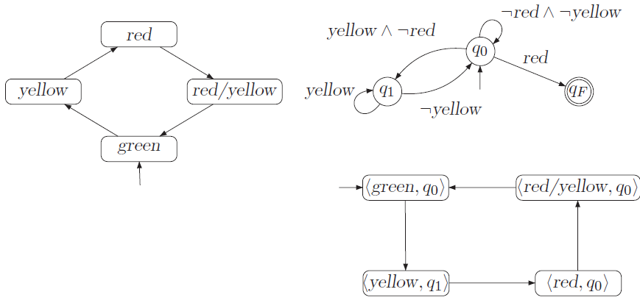
A product TS for German traffic light

Slide 25
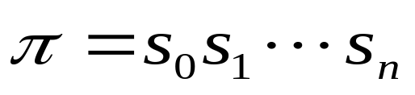
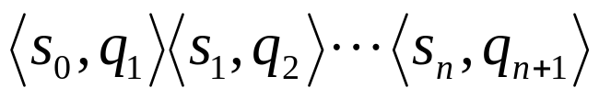


What is the role of NFA in the product
A sequence fragment in TS can be extended to a path fragment
in for which
is a computation of NFA that generates the word

Slide 26
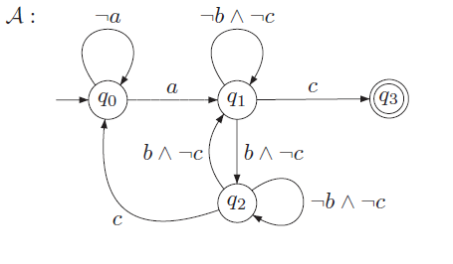
Example

Slide 27
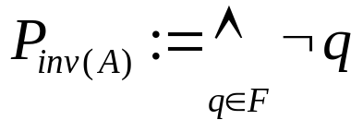
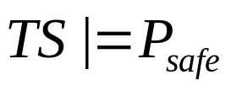
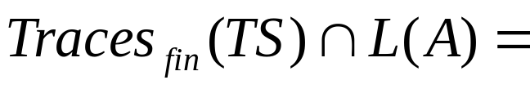
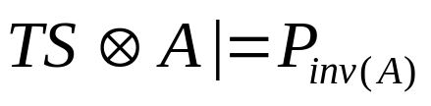
Reducing verification of regular safety property (to what)
Recall that AP’ =Q. Define
L(A)=MinBadPref(Psafe). The following statements are equivalent:
;
0;
.

Slide 28
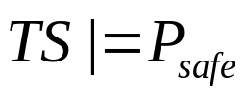


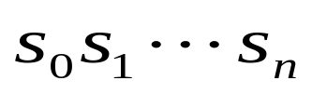

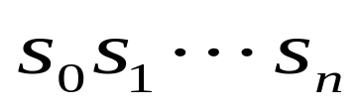
Model checking regular safety properties
In order to check whether , it suffices to check whether
Reachability analysis: Implement the invariant checking of Pinv(A) in .
If the Psafe is refuted, then the algorithm produces a finite path fragment in
where . Correspondingly, we have an initial finite path fragment in TS
such that is accepted by A. So we obtain a counterexample:
(From the above theorem)

Slide 30
Example: the German traffic light
The verified safety property is: a red light phase
Should be immediately preceded by a yellow one.
What if the start state of TS is red instead?

Slide 31
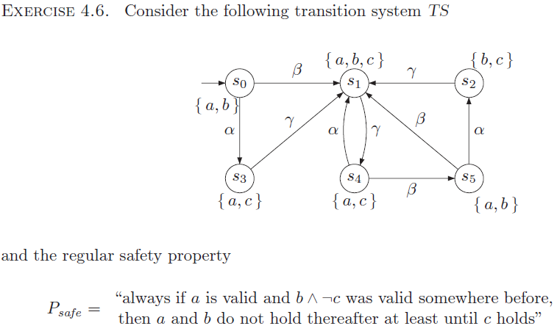
Homework

